Slide 1
Section 3.6
Mathematical Models: Building Functions
Copyright © 2012 Pearson Education, Inc. Publishing as Prentice Hall.

Slide 2

Copyright © 2012 Pearson Education, Inc. Publishing as Prentice Hall.

Slide 3

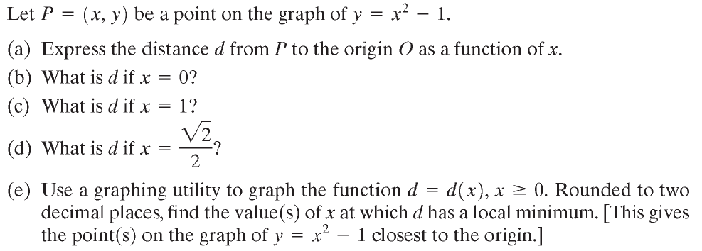



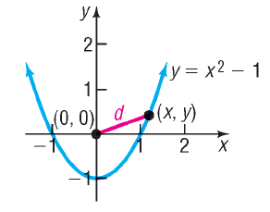


Copyright © 2012 Pearson Education, Inc. Publishing as Prentice Hall.

Slide 4

Copyright © 2012 Pearson Education, Inc. Publishing as Prentice Hall.

Slide 5
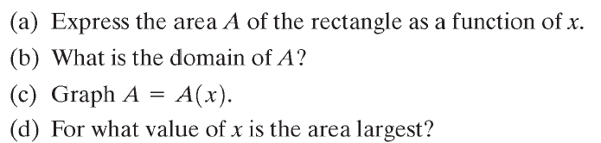
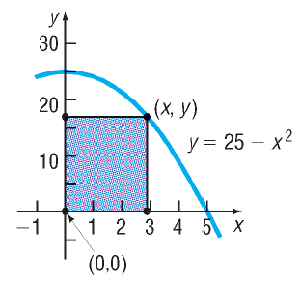

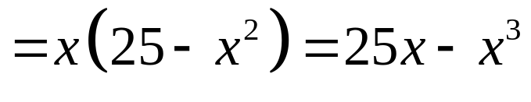
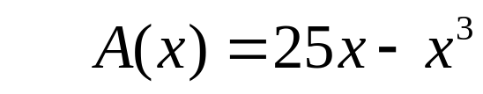
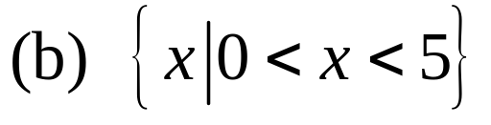
Copyright © 2012 Pearson Education, Inc. Publishing as Prentice Hall.

Slide 6
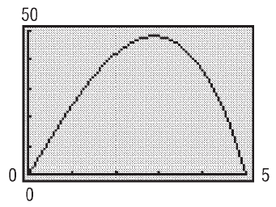
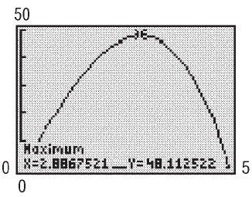
Copyright © 2012 Pearson Education, Inc. Publishing as Prentice Hall.

Slide 7
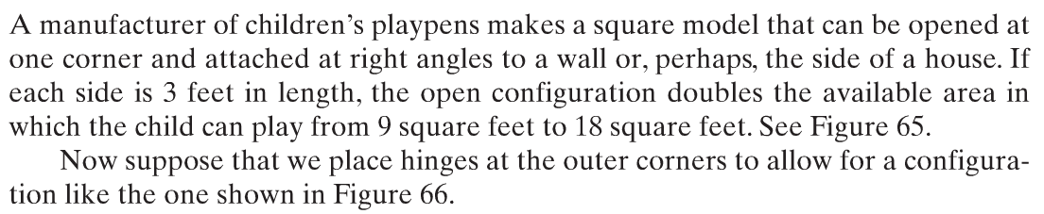
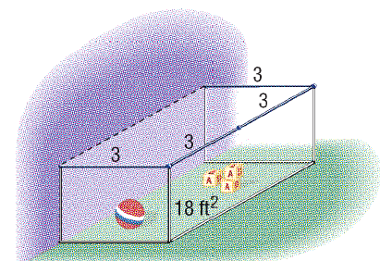


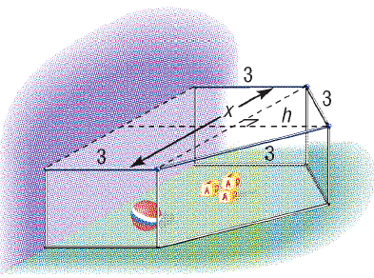



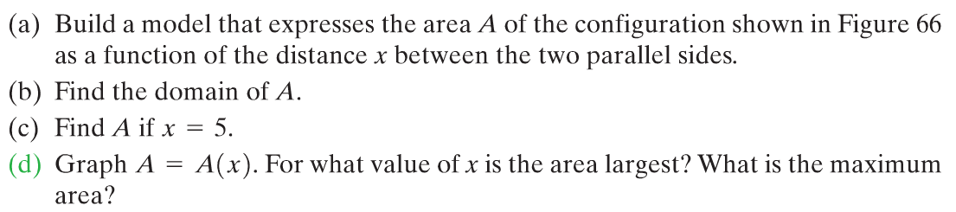
Copyright © 2012 Pearson Education, Inc. Publishing as Prentice Hall.

Slide 8

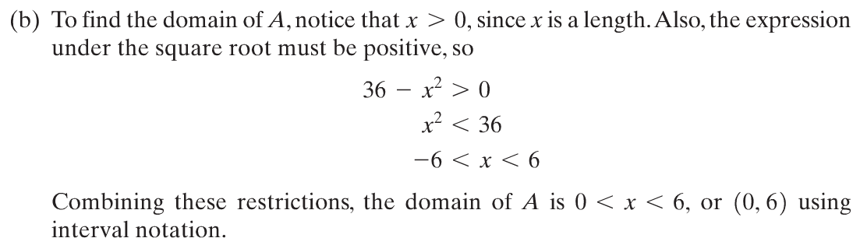
Copyright © 2012 Pearson Education, Inc. Publishing as Prentice Hall.

Slide 9

Copyright © 2012 Pearson Education, Inc. Publishing as Prentice Hall.

Slide 10
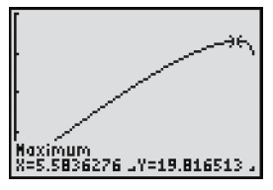
Copyright © 2012 Pearson Education, Inc. Publishing as Prentice Hall.

